Slide 1
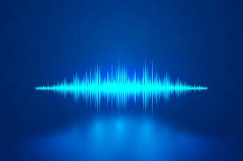

Artificial Intelligence in
Speech Recognition

Slide 2
Introduction
What is the Speech Recognition?
Speech Recognition which means understanding voice by the computer ,Systems and performing any required task .

Slide 3
Where can it be used?
System control/navigation e.g. GPS-connected digital maps: ” How far is it to the motorway junction?”
Voice dialing, Hands-free use of mobile in car e.g. “Dial Office”

Slide 4
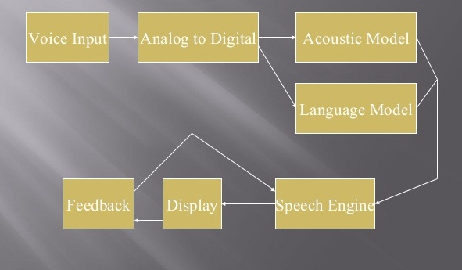
Recognition Works?

Slide 5
Acoustic Model
An acoustic model is created by taking audio recording of speech, and their text transcriptions, and using software to create statistical representations of the sounds that make up each word. It is used by a speech recognition engine to recognize speech.

Slide 6
Language Model
Language model is used in many natural language processing applications such as Speech Recognition tries to capture the properties of a language , and to predict the next word in speech sequence.

Slide 7
Types Of Voice Recognition
Two types of speech recognition.
Speaker-Dependent:
Is commonly used for dictation software.
Speaker-Dependent:
Is more commonly found in telephone applications.

Slide 8
Speaker-Dependent
Speaker-dependent software works by learning the unique characteristic of a single person’s voice, in a way similar to voice recognition.
New users must first “train” the software by speaking to it, so the computer can analyze how the person talks.

Slide 9
Speaker-Independent
Speaker-independent software is designed to recognize anyone’s voice, so no training is involved.
By using a smaller list of recognized words, the speech engine is more likely to correctly recognize what a speaker said.

Slide 10
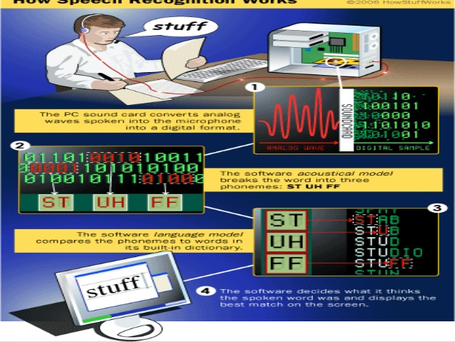

Slide 11
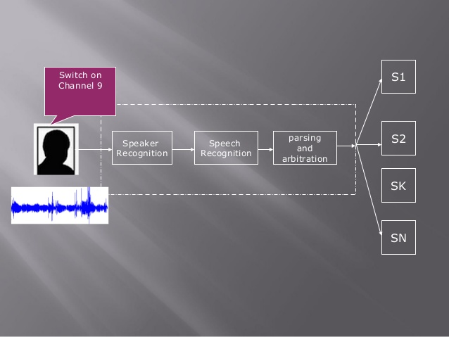

Slide 12
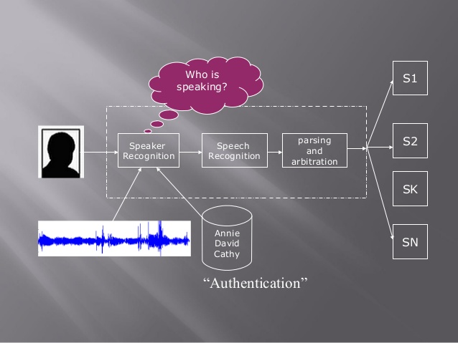

Slide 13
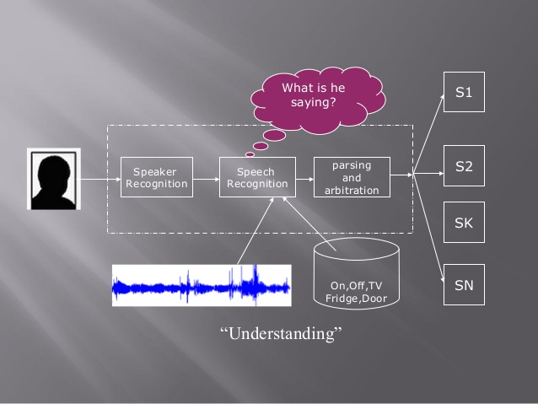

Slide 14
